Slide 1


Radu-Constantin Pîrva
20.03.2022

Slide 2

Outline
Executive Summary
Introduction
Methodology
Results
Conclusion
Appendix

Slide 3
Executive Summary
Summary of methodologies:
Data collection
Data wrangling
Exploratory data analysis with data visualization
Exploratory data analysis with SQL
Building an interactive map with Folium
Building a Dashboard with Plotly Dash
Predictive analysis (Classification)

Slide 4
Executive Summary
Summary of all results
Exploratory data analysis results
Interactive analytics in screenshots
Predictive analytics results

Slide 5
Introduction
Project background and context
Space X advertises Falcon 9 rocket launches on its website with a cost of 62 million dollars; other providers cost upward of 165 million dollars each, much of the savings is because Space X can reuse the first stage. Therefore, if we can determine if the first stage will land, we can determine the cost of a launch. This information can be used if an alternate company wants to bid against space X for a rocket launch. The goal of this project is to use machine learning techniques in order to be able to predict if the first stage will land succesfuly.
Problems we want to find answers for:
Which factors correlate with the rocket landing successfully?
The impact different variables have on the landing outcome.
What conditions are needed in order to achieve the best results?

Slide 6

Section 1

Slide 7
Methodology – Executive Summary
Data collection methodology:
SpaceX Rest API
Web Scrapping
Perform data wrangling:
One Hot Encoding data fields
Dropping irrelevant columns
Dealing with missing values

Slide 8
Methodology – Executive Summary
Perform exploratory data analysis (EDA) using visualization and SQL.
Using scatter and bar graphs to show relationship between variables and to show patterns of data.
Performing interactive visual analytics using Folium and Plotly Dash.
Performing predictive analysis using classification models:
Logistic Regression
SVM
KNN
Decision tree classifier

Slide 9
Data Collection
Data collection included obtaining data from the SpaceX REST API and Web Scraping from a Wikipedia table. Both of these sources were used in order to get a more complete view.

Slide 10
Data Collection – SpaceX API
1.
Using a GET request to obtain data from the SpaceX API
2.
Converting the JSON to a Pandas dataframe
3.
Requesting information using custom functions
https://github.com/radu177/Data-Science-Project/blob/master/Data%20Collection%20API.ipynb

Slide 11
Data Collection – SpaceX API
4.
Assigning data to a dictionary and creating a data frame from it
5.
Filtering the dataframe to only contain information about Falcon 9
6.
Dealing with missing values
7.
Exporting the data to CSV
https://github.com/radu177/Data-Science-Project/blob/master/Data%20Collection%20API.ipynb

Slide 12
Data Collection - Scraping
1.
Requesting Falcon 9 launch Wiki page
2.
Creating a BeautifulSoup object from the HTML response
3.
Extracting all column names from the HTML table Header
4.
Creating a dataframe by parsing HTML tables

Slide 13
Data Collection - Scraping
5.
Constructing data into a dictionary
6.
Creating a dataframe from the dictionary
7.
Exporting the data to CSV
https://github.com/radu177/Data-Science-Project/blob/master/Data%20Collection%20with%20Web%20Scraping.ipynb

Slide 14
Data Wrangling
Exploratory Data Analysis (EDA) was performed in order to find some patterns in the data and determine what would be the label for training supervised models.
In the data set, there are several different cases where the booster did not land successfully. Sometimes a landing was attempted but failed due to an accident; for example, True Ocean means the mission outcome was successfully landed to a specific region of the ocean while False Ocean means the mission outcome was unsuccessfully landed to a specific region of the ocean. True RTLS means the mission outcome was successfully landed to a ground pad False RTLS means the mission outcome was unsuccessfully landed to a ground pad.True ASDS means the mission outcome was successfully landed on a drone ship False ASDS means the mission outcome was unsuccessfully landed on a drone ship.
The outcomes were converted into Training Labels with 1 means the booster successfully landed 0 means it was unsuccessful.
https://github.com/radu177/Data-Science-Project/blob/master/Data%20Wrangling.ipynb

Slide 15
Data Wrangling
1.
Calculating the number of launches at each site
2.
3.
Calculating the number and occurrence of mission outcome per orbit type
Calculating the numbar and occurrence of each orbit
4.
Create landing outcome label from Outcome column
5.
Exporting data as csv
https://github.com/radu177/Data-Science-Project/blob/master/Data%20Wrangling.ipynb

Slide 16
EDA with Data Visualization
Multiple plot types were used:
A scatterplot shows the relationship between two quantitative variables.
- Flight Number vs. Payload Mass
- Flight Number vs. Launch Site
- Payload Mass vs. Launch Site
- Flight Number vs. Orbit Type
- Payload vs. Orbit type
A bar chart shows the relationship between a numeric and a categoric variable. Each entity of the categoric variable is represented as a bar. The size of the bar represents its numeric value.
- Orbit Type and Success Rate
A line chart shows the trend of a variable over time.
- Success Rate VS. Year
.
https://github.com/radu177/Data-Science-Project/blob/master/EDA%20Visualization.ipynb

Slide 17
EDA with SQL
SQL queries that were performed:
Displaying the names of the unique launch sites in the space mission
Displaying 5 records where launch sites begin with the string 'CCA'
Displaying the total payload mass carried by boosters launched by NASA (CRS)
Displaying average payload mass carried by booster version F9 v1.1
Listing the date when the first successful landing outcome in ground pad was acheived.
https://github.com/radu177/Data-Science-Project/blob/master/EDA.ipynb

Slide 18
EDA with SQL
SQL queries that were performed:
Listing the names of the boosters which have success in drone ship and have payload mass greater than 4000 but less than 6000
Listing the total number of successful and failure mission outcomes
Listing the names of the booster_versions which have carried the maximum payload mass
Listing the failed landing_outcomes in drone ship, their booster versions, and launch site names for in year 2015
Ranking the count of landing outcomes (such as Failure (drone ship) or Success (ground pad)) between the date 2010-06-04 and 2017-03-20, in descending order
https://github.com/radu177/Data-Science-Project/blob/master/EDA.ipynb

Slide 19
Build an Interactive Map with Folium
Using Folium, the launch data was visualised in an interactive map.
Using the coordinates of each launch site a Circle Marker was added around them and labeled.
The launch outcomes were represented by green or red markers on a map using a MarkerCluster.
By using Haversine’s formula the distances from the launch site to various landmarks were calculated in order to find trends about the surrounding area. Lines were drawn on the map using PolyLine in order to represent the distances.
https://github.com/radu177/Data-Science-Project/blob/master/Interactive%20Visual%20Analytics%20with%20Folium.ipynb

Slide 20
Build a Dashboard with Plotly Dash
The dashboard app contains a pie chart and a scatter chart.
Pie chart: by selecting from a dropdown menu it can show the total success percentage for all sites or for a specific launch site.
Scatter chart: shows the relationship between outcomes and payload mass. It has slider between 0 and 10000 which allows you to select a range of values for the payload mass to be displayed. The chart also shows the booster version.
https://github.com/radu177/Data-Science-Project/blob/master/spacex_dash_app.py

Slide 21
Predictive Analysis (Classification)
Standardizing the data using StandardScaler and then fitting and transforming it
Loading the dataframe and creating a NumPy array using the Class column
Splitting the data into a training and a testing set using train_test_split
Calculating the accuracy on test data by using the score() method.
Evaluating the confusion matrix of each model
Finding the best model by using the Jaccard and F1 scores
Creating a GridSearchCV object and then applying it on different models: LogReg, SVM, Decision Tree and KNN
The main steps are building, evaluating, improving the model and then finding the best performing one.
https://github.com/radu177/Data-Science-Project/blob/master/Machine%20Learning%20Prediction.ipynb

Slide 22
Results
Exploratory data analysis results
Interactive analytics demo in screenshots
Predictive analysis results

Slide 23

Section 2

Slide 24
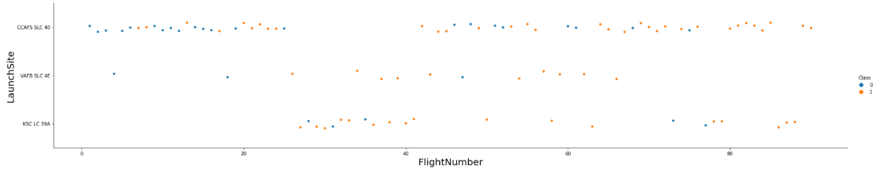
Flight Number vs. Launch Site
This scatter plot suggests that as the flight number increases the success rate also increases.
Launch site CCAFS SLC-40 has the highest number of launches.

Slide 25
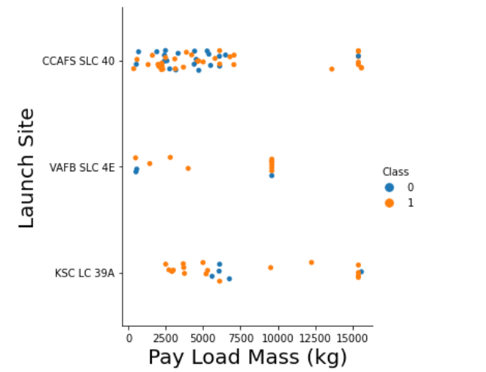
Payload vs. Launch Site
In this graph we can observe that with higher payload mass there seems to be an increase in successful landings, especially at launch site CCAFS SLC 40.
Most launches with a payload of over 7500 kg were successful.
At launch site KSC LC 39A all launches with a payload of less than 5000 kg were successful.

Slide 26
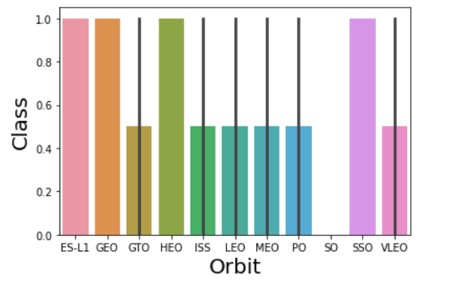
Success Rate vs. Orbit Type
Orbits ES-L1, GEO, HEO, SSO have a 100% success rate.
Orbit SO has a 0% success rate.
Other orbits have a success rate of around 50%.

Slide 27
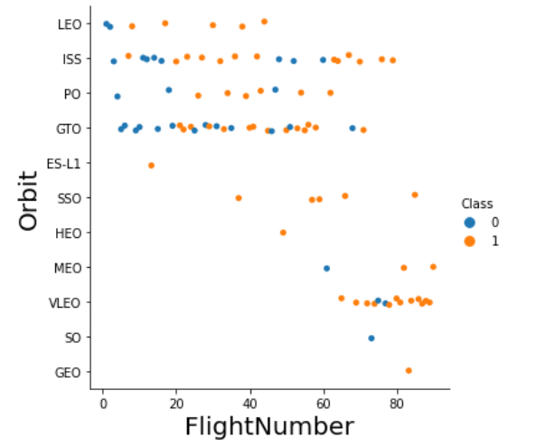
Flight Number vs. Orbit Type
A trend towards higher success rates can be seen in multiple orbits with increasing flight numbers, especially for the LEO orbit.
All launches in the SSO orbit were successful.

Slide 28
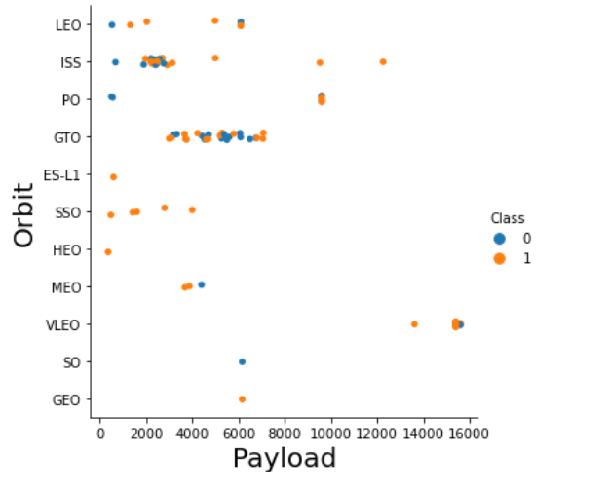
Payload vs. Orbit Type
Heavy payloads seem to have had a negative influence for VLEO and MEO orbits and a positive influence on the succes rate of the ISS and PO.

Slide 29
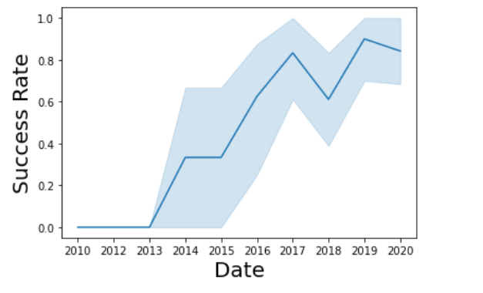
Launch Success Yearly Trend
The success rate has increased from 2013 to 2017 after which it had a drop to about 0.6 in 2018, but which later increased again for 2019. A small drop in success rate is seen in 2020, but the overall trend of the graph suggests an increase in success rate over time.

Slide 30
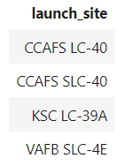
All Launch Site Names
Finding the names of the unique launch sites. The sql query used:
Query results:
Using the word DISTINCT in the query will return unique values from the LAUNCH_SITE column.

Slide 31
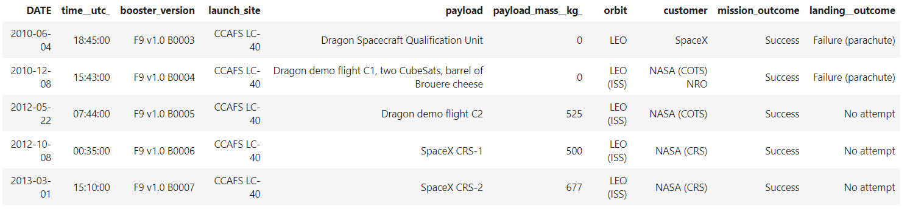
Launch Site Names Begin with 'CCA'
Finding 5 records where launch sites begin with `CCA`. The query used:
Query result:
Using the keywords LIMIT 5 in the query will return 5 records from table. Then, the condition LIKE was used with a wild card “CCA%” – this will filter the results to show only names that begin with ‘CCA’.

Slide 32
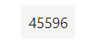
Total Payload Mass
Calculating the total payload carried by boosters from NASA. The query used:
Result:
The SUM keyword adds up the values in the selected column. WHERE filters the data(here it is set to return only the rows in which the customer is ‘NASA (CRS)’).

Slide 33
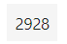
Average Payload Mass by F9 v1.1
Calculating the average payload mass carried by booster version F9 v1.1. The query used:
Result:
The AVG function calculates the average of the values from the selected column. In this case the values used from the column were filtered by the WHERE clause to include only the rows with a booster version F9 v1.1.

Slide 34
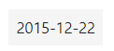
First Successful Ground Landing Date
Finding the dates of the first successful landing outcome on ground pad. The query used:
The result:
The MIN function finds the minimum value from the selected column and the WHERE clause filters the data to only include the rows with a successful landing outcome.

Slide 35
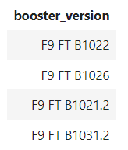
Successful Drone Ship Landing with Payload between 4000 and 6000
Listing the names of boosters which have successfully landed on drone ship and had payload mass greater than 4000 but less than 6000. The query used:
The result:
In this case the WHERE clause was used with multiple filters linked together by the AND keyword.
The BETWEEN 4000 and 6000 condition was used to specify an interval of values.

Slide 36
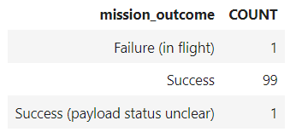
Total Number of Successful and Failure Mission Outcomes
Calculating the total number of successful and failure mission outcomes. The query used:
The result:
The data was grouped by the outcome using GROUP BY and then each group was counted by using the COUNT function.

Slide 37
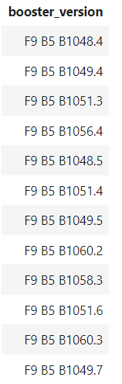
Boosters Carried Maximum Payload
Listing the names of the boosters which have carried the maximum payload mass. The query used:
Result:
The function MAX finds the maximum payload in the column PAYLOAD_MASS_KG. Using these values, the clause WHERE filters the results to only include the rows with the maximum payload mass.

Slide 38
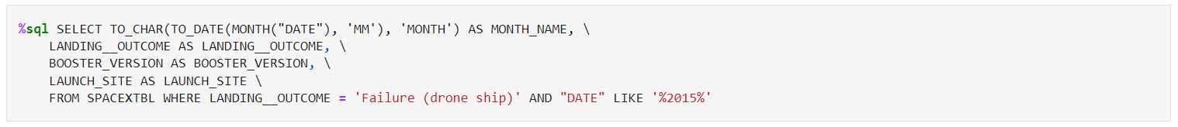
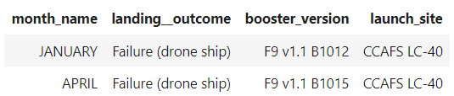
2015 Launch Records
Listing the failed landing_outcomes in drone ship, their booster versions, and launch site names for in year 2015. The query used:
Results:
Two conditions were used for the WHERE clause: a date LIKE ‘%2015%’ and an outcome of ‘Failure (drone ship)’.

Slide 39
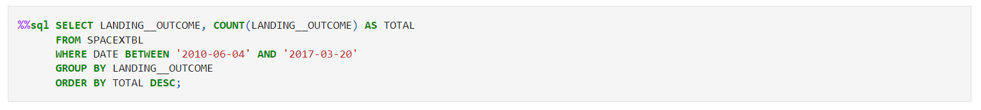
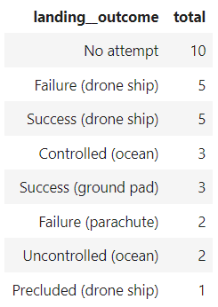
Rank Landing Outcomes Between 2010-06-04 and 2017-03-20
Ranking the count of landing outcomes between the date 2010-06-04 and 2017-03-20, in descending order:
Result:
This query uses the function COUNT in order to count the records in the column LANDING__OUTCOME filtered from a certain time interval by using the WHERE clause and that are grouped by the LANDING_OUTCOME.
The ORDER BY clause and then the DESC keyword used at the end places the results in descending order.

Slide 40

Section 3

Slide 41
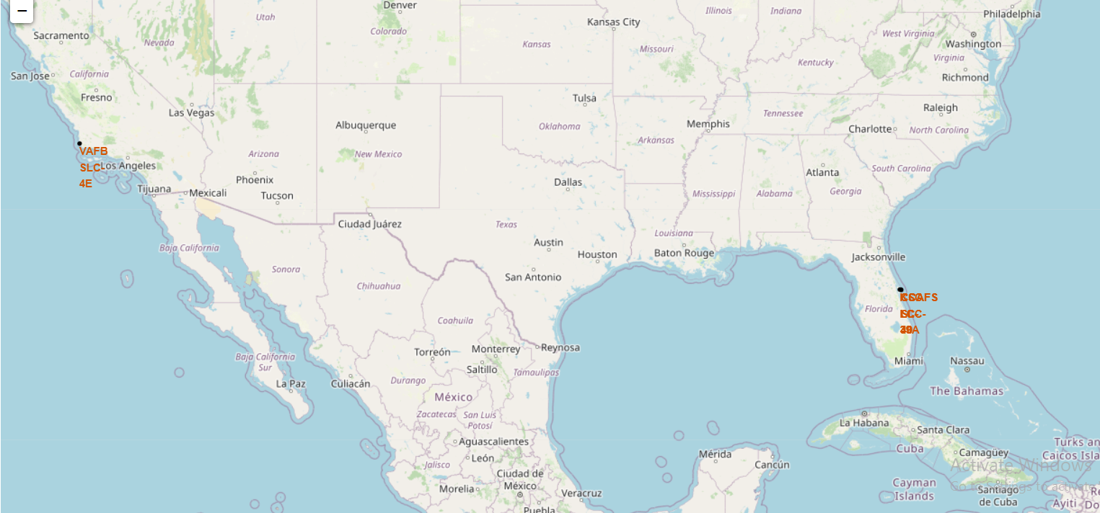
Launch sites marked on a Folium map
This map shows the locations of the launch sites which are in California and Florida. They are located near the coastline and relatively far away from densely populated areas.

Slide 42
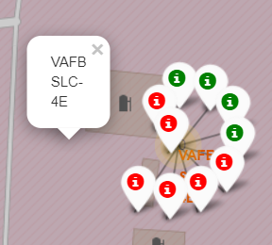
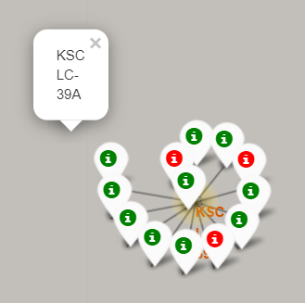
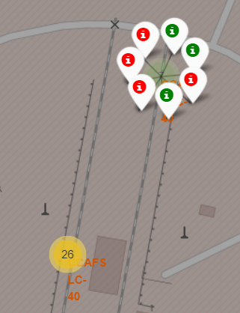
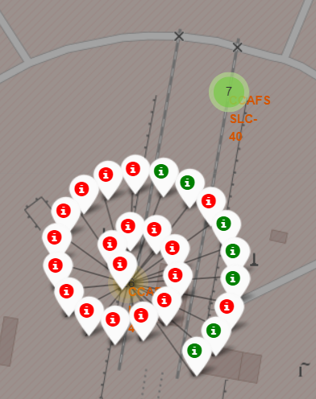
Color success markers
In these marker clusters successful landings are displayed in green and failed landings in red.

Slide 43
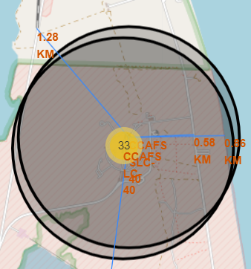
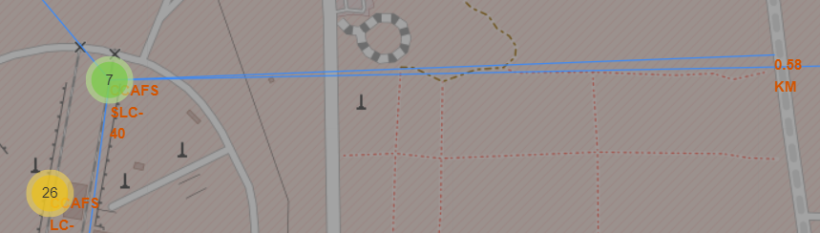
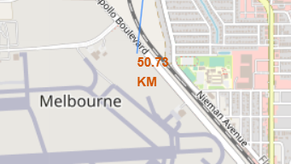
Launch site vicinities
Calculating distances between the CCAFS-SLC-40 site and different landmarks.
Are launch sites in close proximity to railways? No
Are launch sites in close proximity to highways? No
Are launch sites in close proximity to coastline? Yes
Do launch sites keep certain distance away from cities?Yes

Slide 44

Section 4

Slide 45
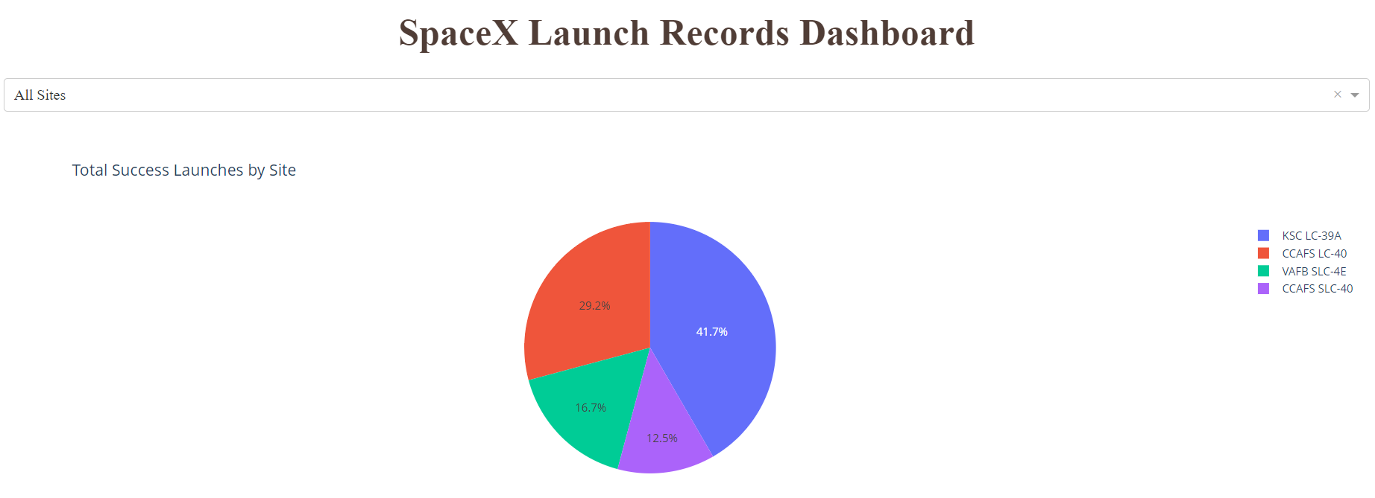
Success rate across all sites
The pie chart shows KSC LC-39A as being the most successful launch site.

Slide 46
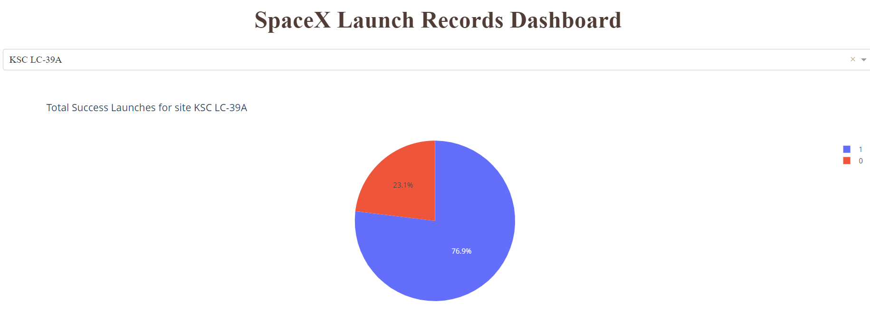
Most successful launch site
KSC LC-39A achieved a 76.9% success rate.

Slide 47
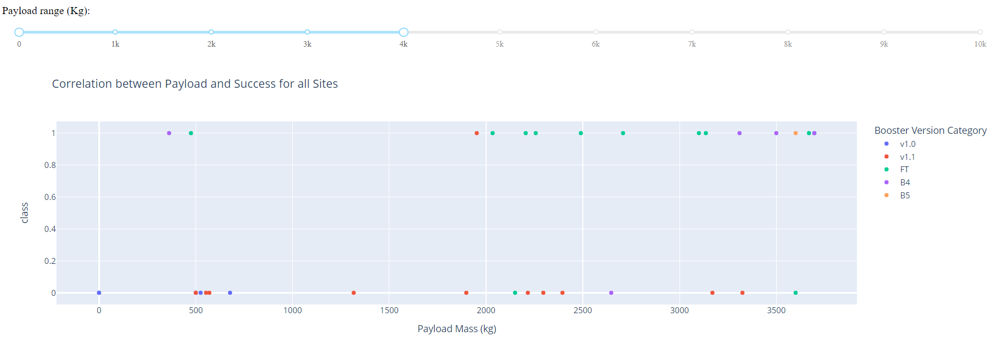
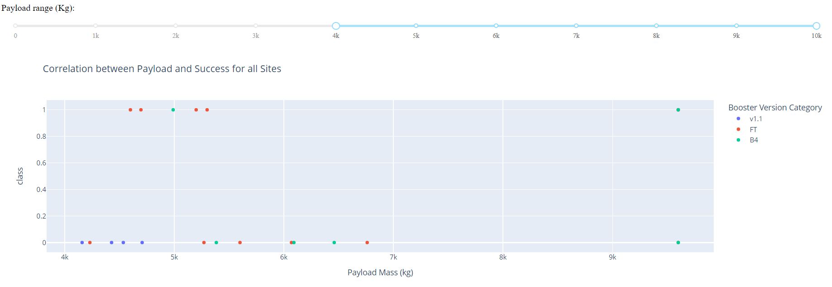
Payload vs. Launch Outcome scatter plot
This scatter plot suggests that the success rates for lighter payloads are higher than for the heavy ones.

Slide 48

Section 5

Slide 49
Classification Accuracy
Best performing algorithm is Decision Tree, with a calculated accuracy of approximately 0.887.

Slide 50
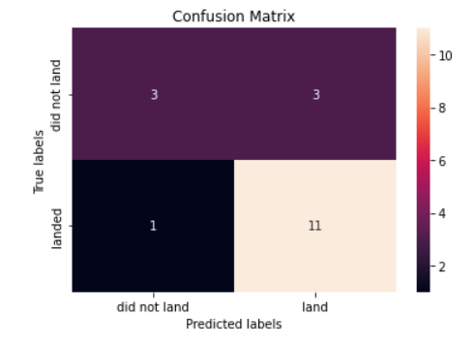
Decision tree confusion matrix
Confusion matrix metrics:
True Positive: 11
False Positive: 3
True Negative Rate: 3
False Negative: 1
Accuracy: (TP+TN)/total = 0.77
Misclassification Rate: (FP+FN)/total = 0.22
Precision: TP/TP + FP = 0.78

Slide 51
Conclusions
The success rate for SpaceX launches has generally been increasing with time.
The decision tree algorithm is the best machine learning model for this datatset, having an accuracy of approximately 0.88.
A positive correlation between number of flights and success rate has been noted.
Launch site KSC LC-39A had the highest success rate (76.9%).
Orbits ES-L1, GEO, HEO, SSO have a 100% success rate.
Lighter payloads seem to be correlated with higher success rates.

Slide 52
Appendix
GitHub repo link:
https://github.com/radu177/Data-Science-Project.git

Slide 53


